Slide 1


Brain Tumor Detection
Ashutosh Jha – 210907370 Utkarsh Kumar – 210907246 Sankalp Tripathy - 210907270

Slide 2
Contents
Introduction
Objective
Dataset
Methodology
Results
Finding/Discussion
Conclusion and Future Scope
References

Slide 3
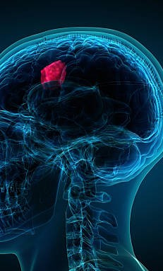
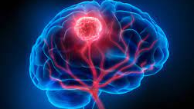
Introduction
In recent years, the convergence of medical imaging technology and artificial intelligence has paved the way for transformative innovations in healthcare. Among these, neural networks have emerged as a powerful tool for enhancing diagnostic accuracy and efficiency.
In this presentation, we will delve into the potential of neural networks to revolutionize the landscape of brain tumor detection.
We'll explore how these advanced computational models can leverage vast amounts of medical data, including MRI and CT scans, to recognize patterns indicative of brain tumors with remarkable precision, enabling earlier and more accurate diagnoses.
Moreover, their ability to continuously learn and adapt from new data holds the promise of continual improvement and refinement in diagnostic accuracy over time.

Slide 4
Objective
Develop 3 different CNNs for Brain Tumor Detection and compare their performance using standard metrics and also perform some basic image processing tasks to see how good the images in the dataset are for training and testing the model

Slide 5
Dataset
The dataset is consisting of 253 MRI images. 155 are tumorous while 98 are non-tumorous. These have been taken from Kaggle and are open-source.
This is a smaller dataset and is also imbalanced. So, we perform data augmentation to create more images by varying, the height, width and brightness of the images as well as rotating them and flipping them horizontally and vertically.
This gives us a final dataset of 2065 images with 1085 tumorous images and 980 non-tumorous images.
We have split this data into 3 parts: 70% for training, 15% for validation and 15% for testing.

Slide 6
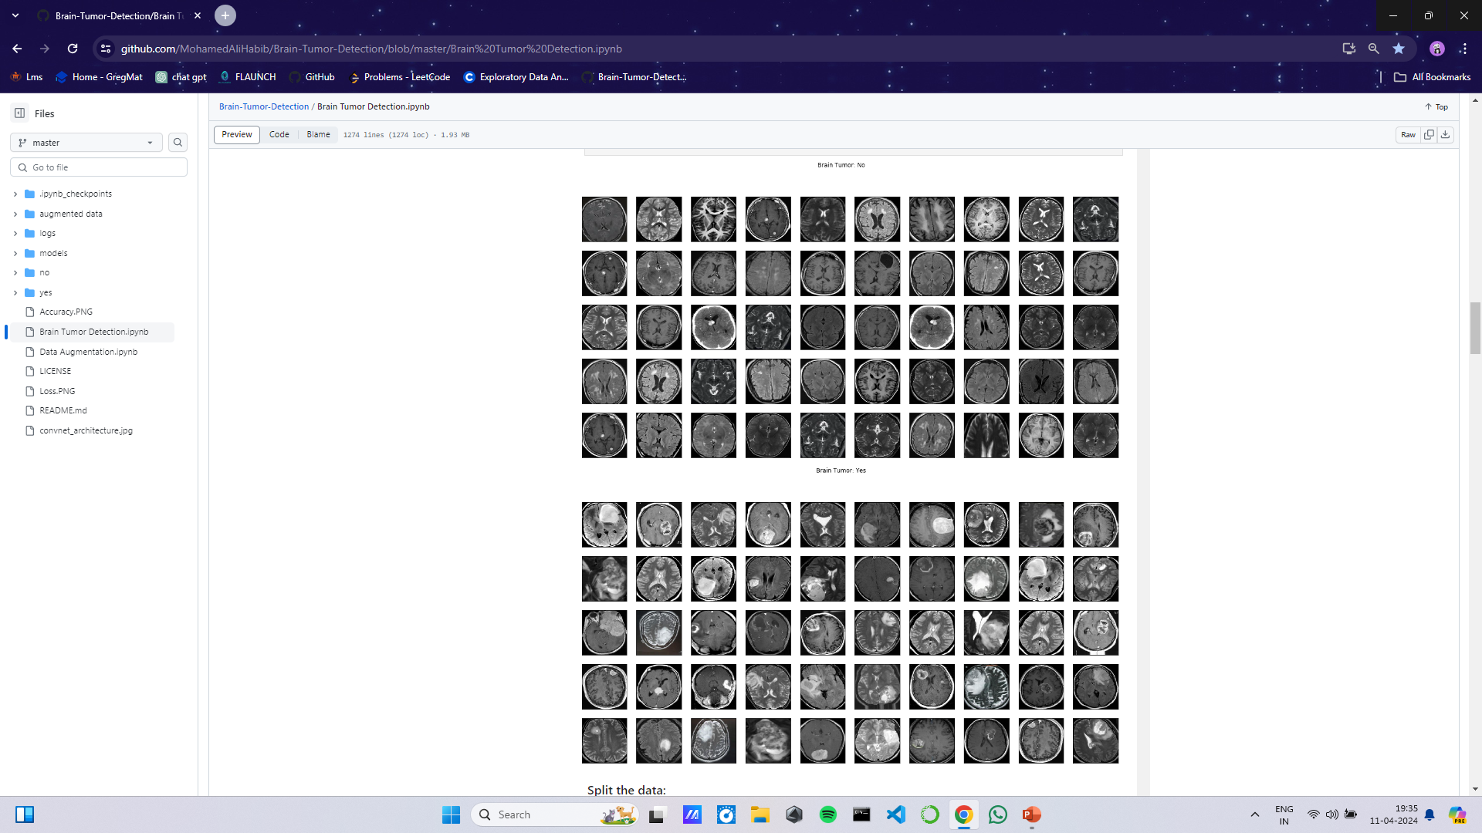
Dataset
Sample Images In The Dataset

Slide 7
Dataset
Sample Images In The Dataset

Slide 8
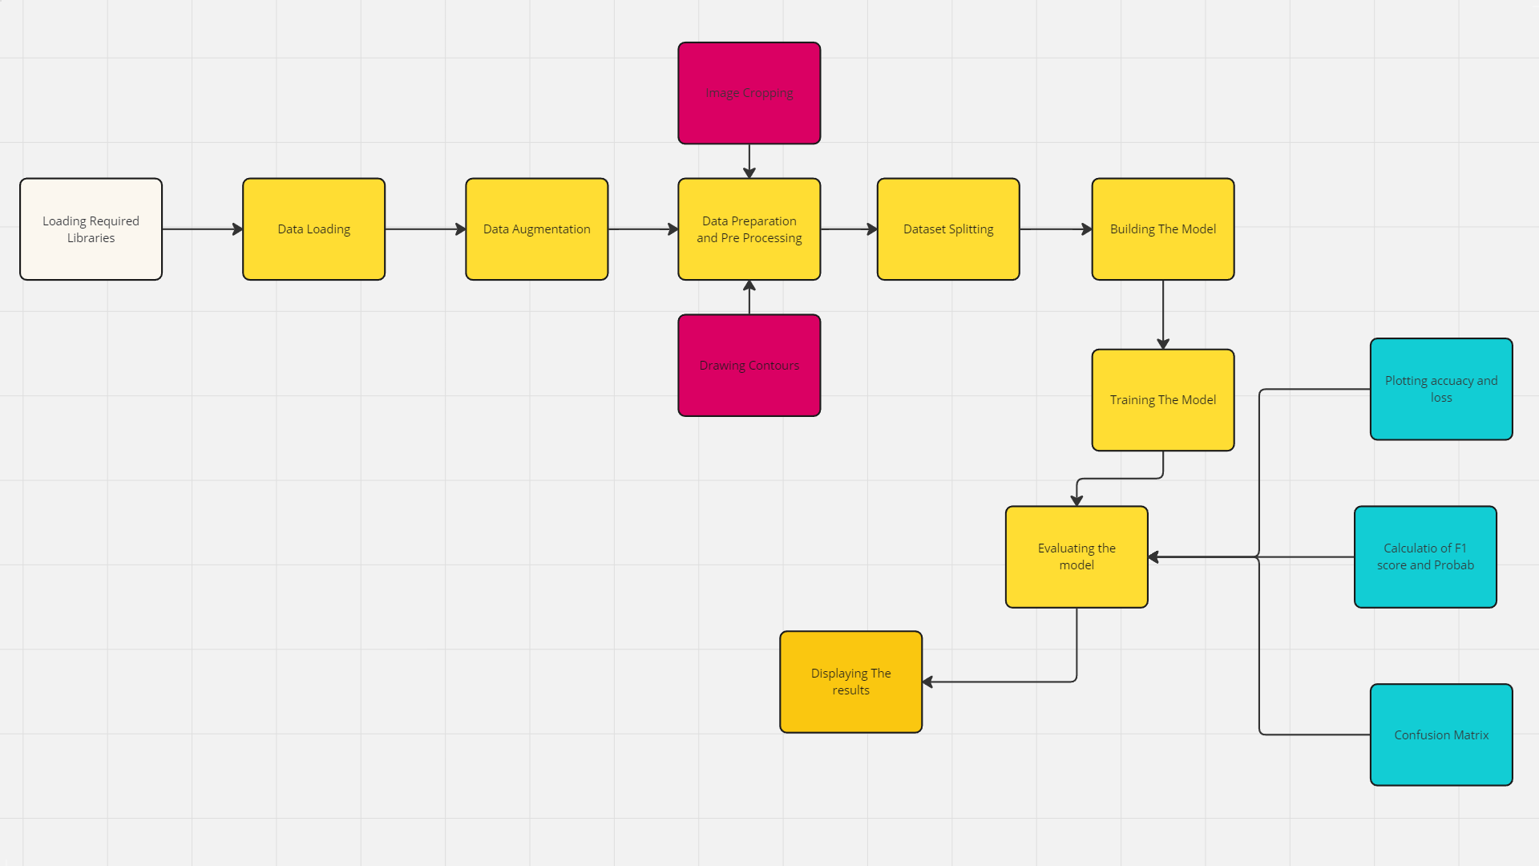
Methodology
FLOWCHART

Slide 9
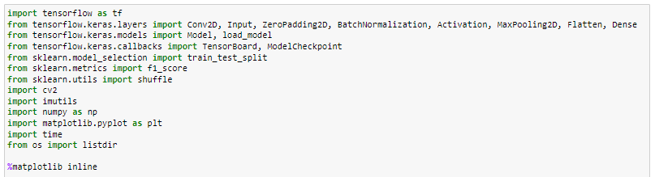
Methodology
Importing Required Libraries : In this step we import all the required libraries and functions which will later be used to perform various operations in the project.

Slide 10
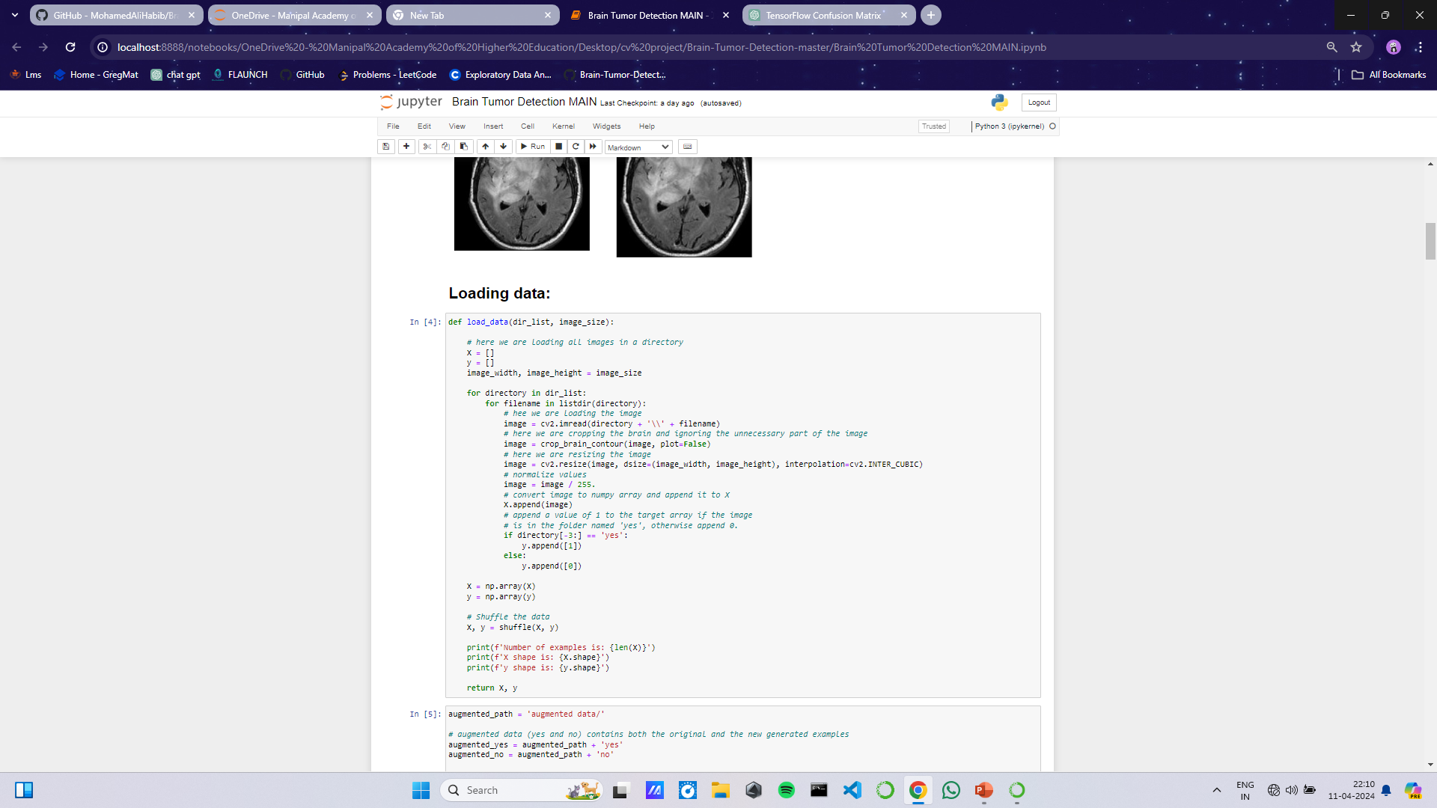
Methodology
Data Loading : In this step we are loading the data from the directories and the converting them into arrays using numpy and later we are also shuffling the data so that we get to see results on different images everytime.

Slide 11
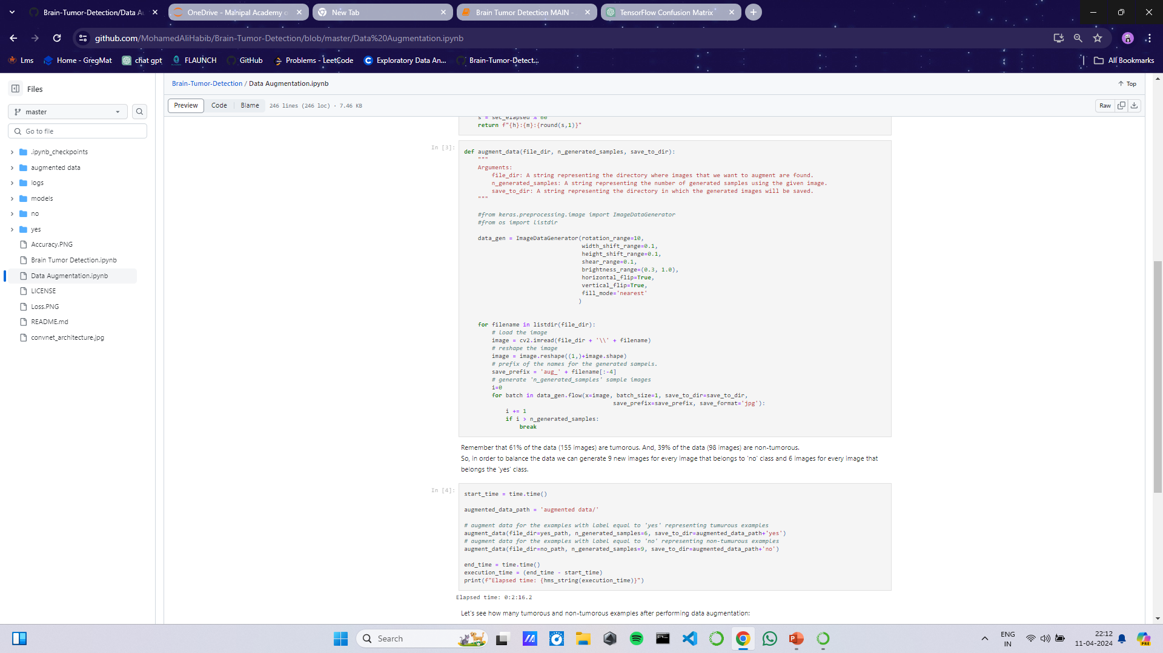
Methodology
Data Augmentation : Since this is a small dataset, There wasn't enough examples to train the neural network. Also, data augmentation was useful in tackling the data imbalance issue in the data.

Slide 12
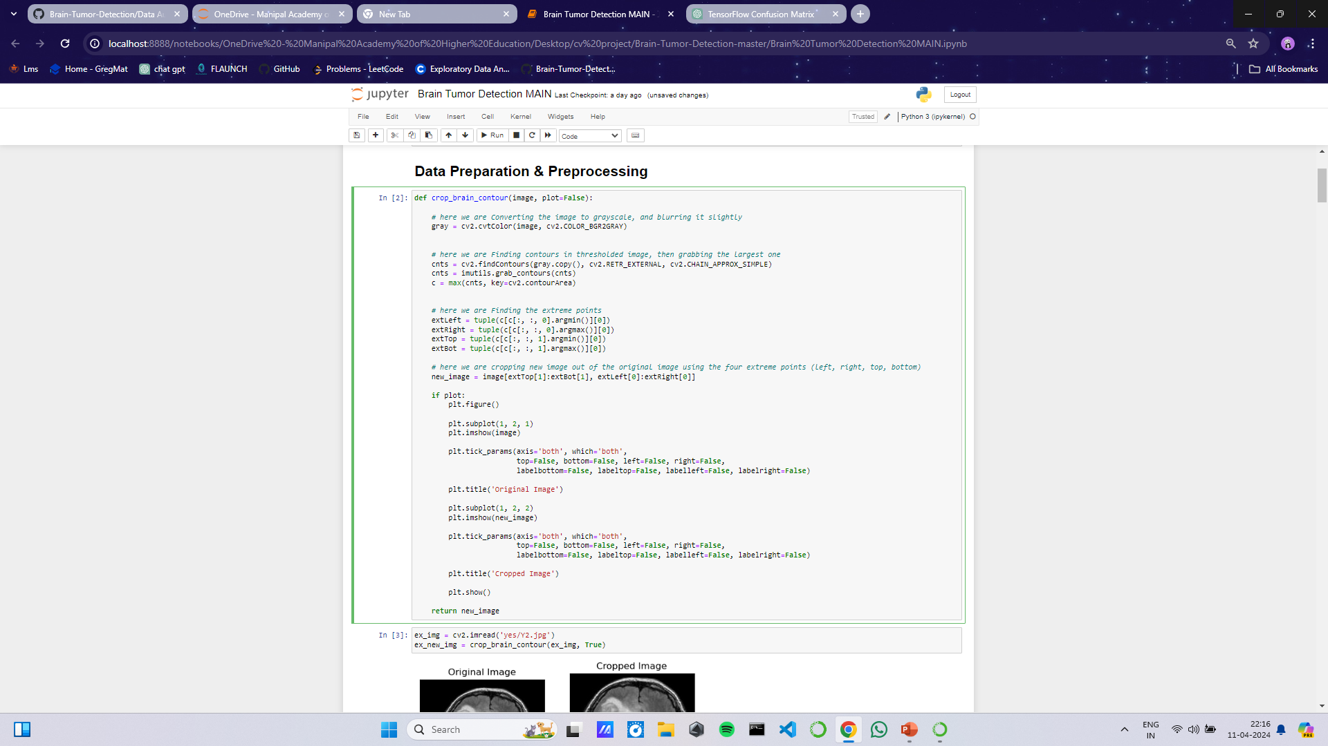
Methodology
Data Preparation and Pre-Processing :
For every image, the following preprocessing steps were applied:
Crop the part of the image that contains only the brain (which is the most important part of the image).

Slide 13
Methodology
Explanation:
To extract the brain region from an input image we use the crop_brain_contour function.
image: its the input image that must be used to extract the necessary brain region.
To make further processing easier,
cv2.cvtColor() converts the input image to grayscale.
The grayscale image's contours are found using cv2.findContours().
Using max(cnts, key=cv2.contourArea), the largest contour—which is considered to be the brain region—is chosen based on its area.
The selected contour's extreme points—its leftmost, rightmost, topmost, and bottommost—are identified.
Using these extreme points, a new image is cropped from the original image such that just the brain's region is shown.

Slide 14
Methodology
Data Preparation and Pre-Processing :
2. Resize the image to have a shape of (240, 240, 3)=(image_width, image_height, number of channels): because images in the dataset come in different sizes. So, all images should have the same shape to feed it as an input to the neural network.
# here we are resizing the image
image = cv2.resize(image, dsize=(image_width, image_height), interpolation=cv2.INTER_CUBIC)
3. Apply normalization: to scale pixel values to the range 0-1.
# normalize values
image = image / 255.

Slide 15
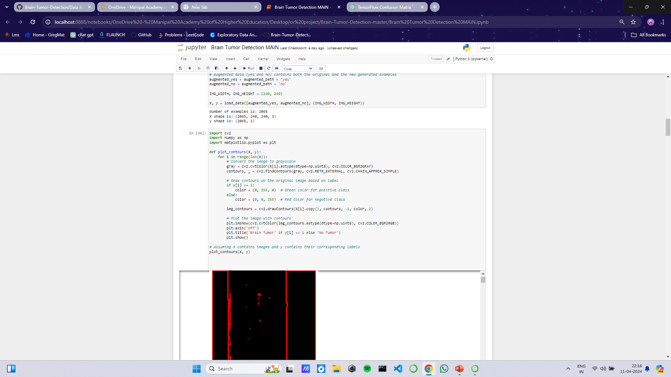
Methodology
Data Preparation and Pre-Processing :
4. Plotting Contours :

Slide 16
Methodology
Explanation:
The purpose of the plot_contours function is to display images with contours applied according to their labels.
The following actions are taken by the function for every image in the input list X:
creates a grayscale image by using cv2.cvtColor().
cv2.findContours() is used to find contours in the grayscale image.
Draws the detected contours on a copy of the original image based on the corresponding label. Green contours are drawn for images labeled as positive (brain tumor present), and red contours are drawn for images labeled as negative (no tumor)..
uses Matplotlib to display the image with the sketched contours.

Slide 17
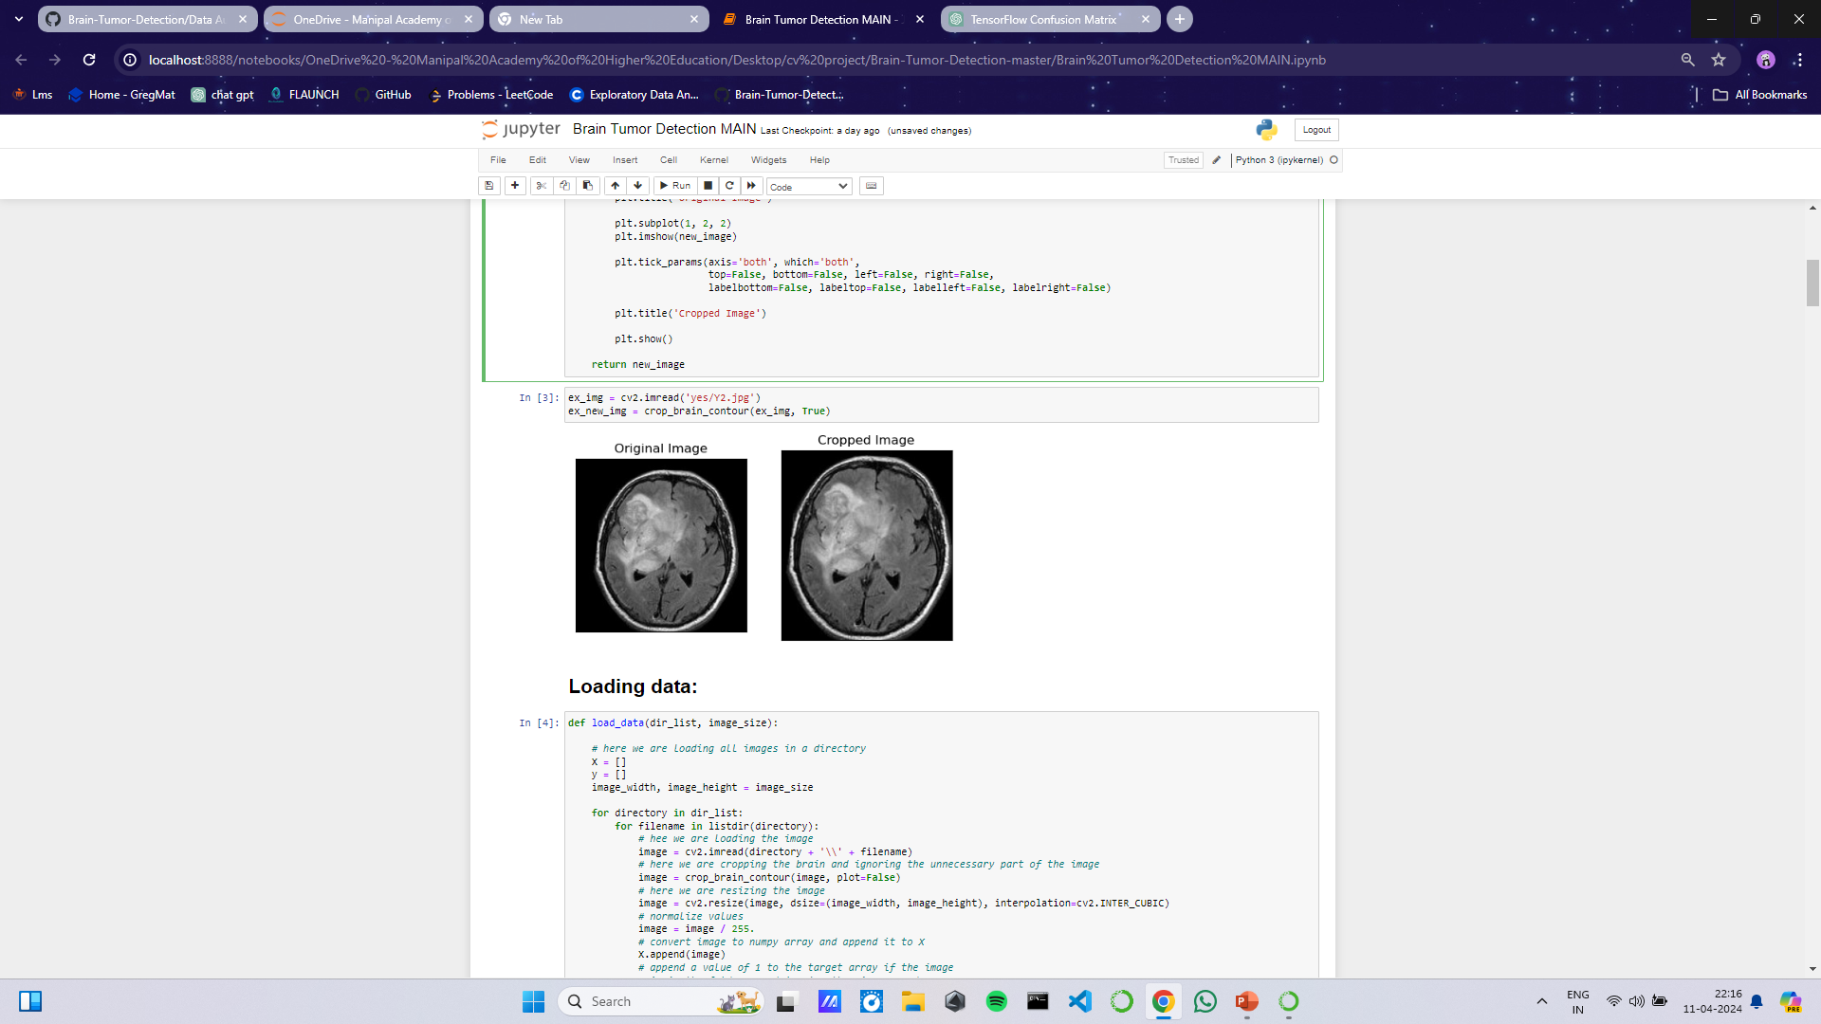
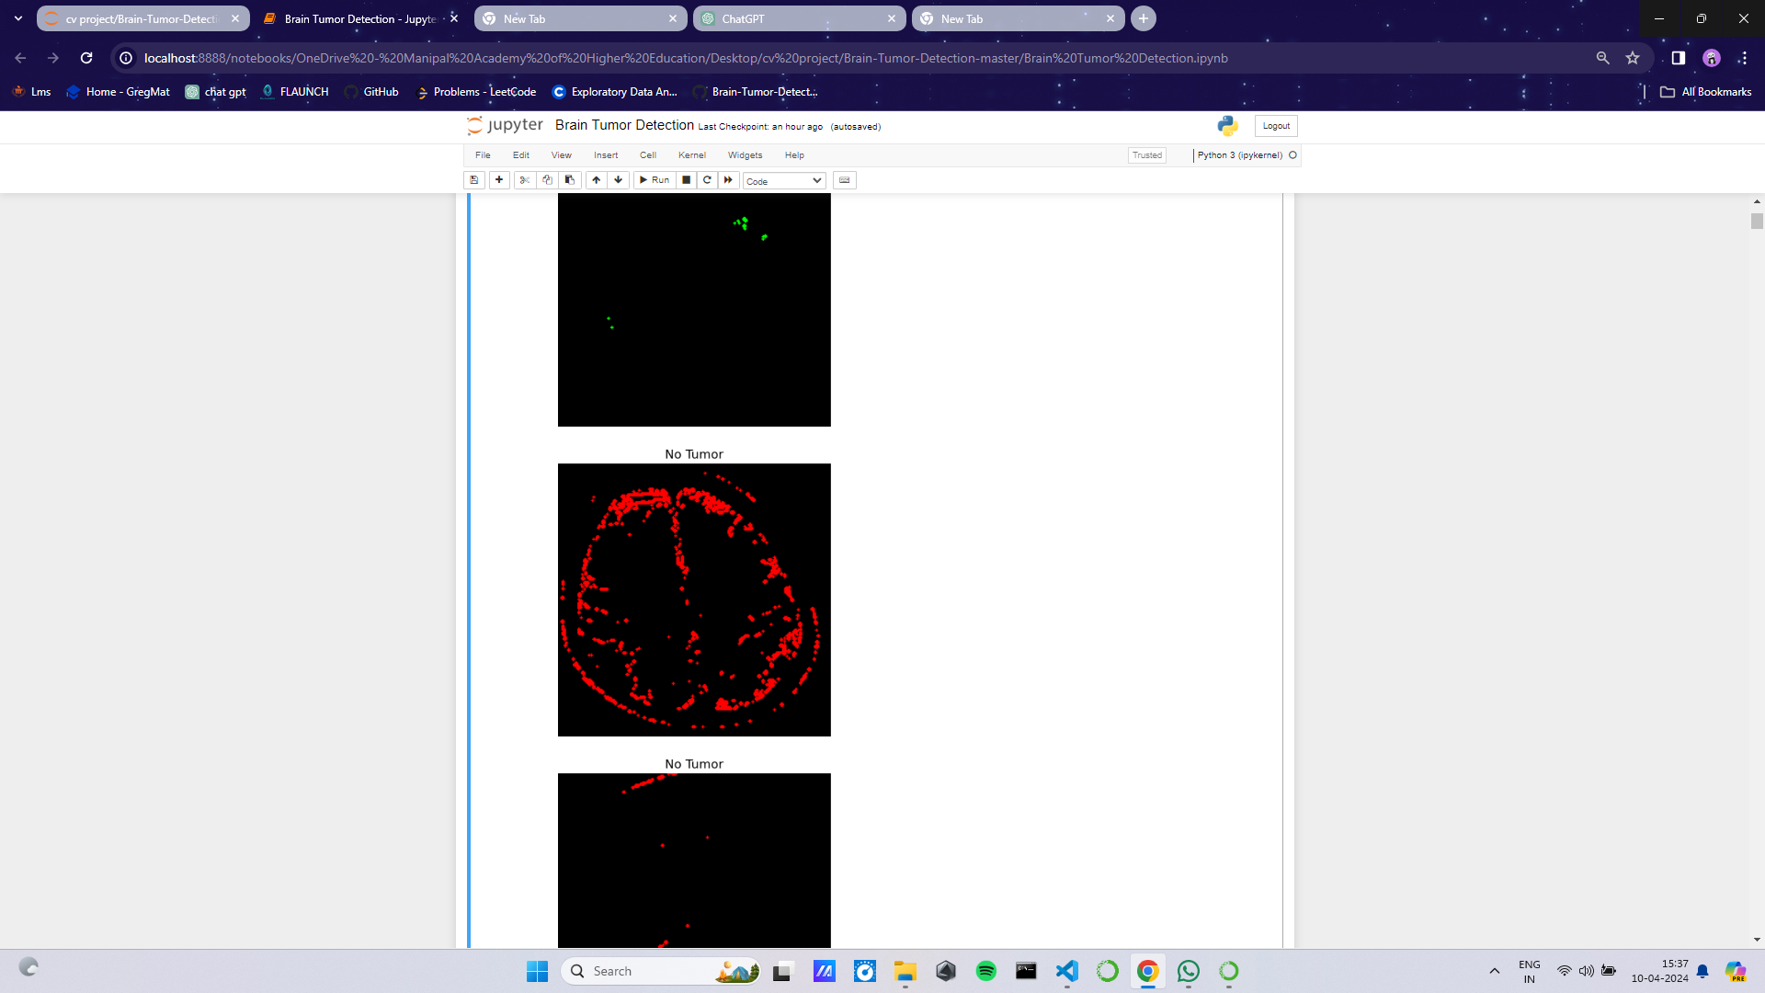
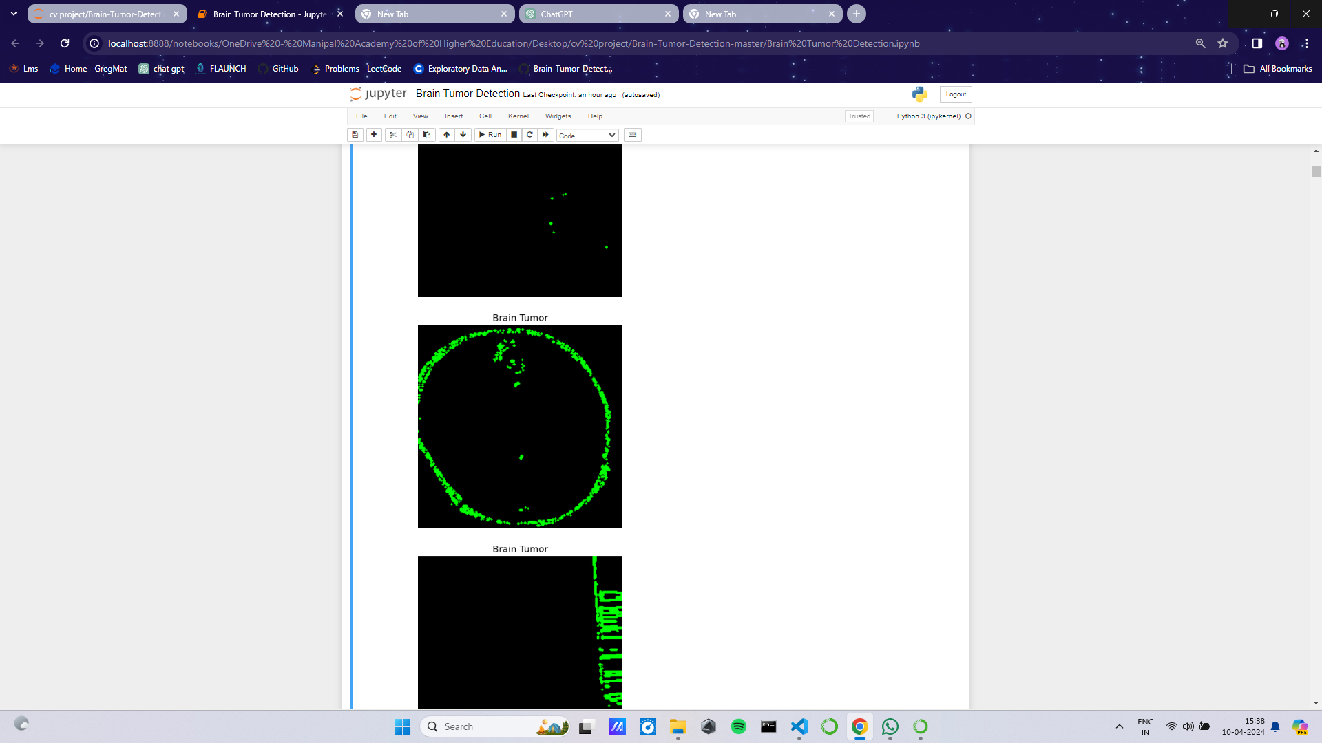
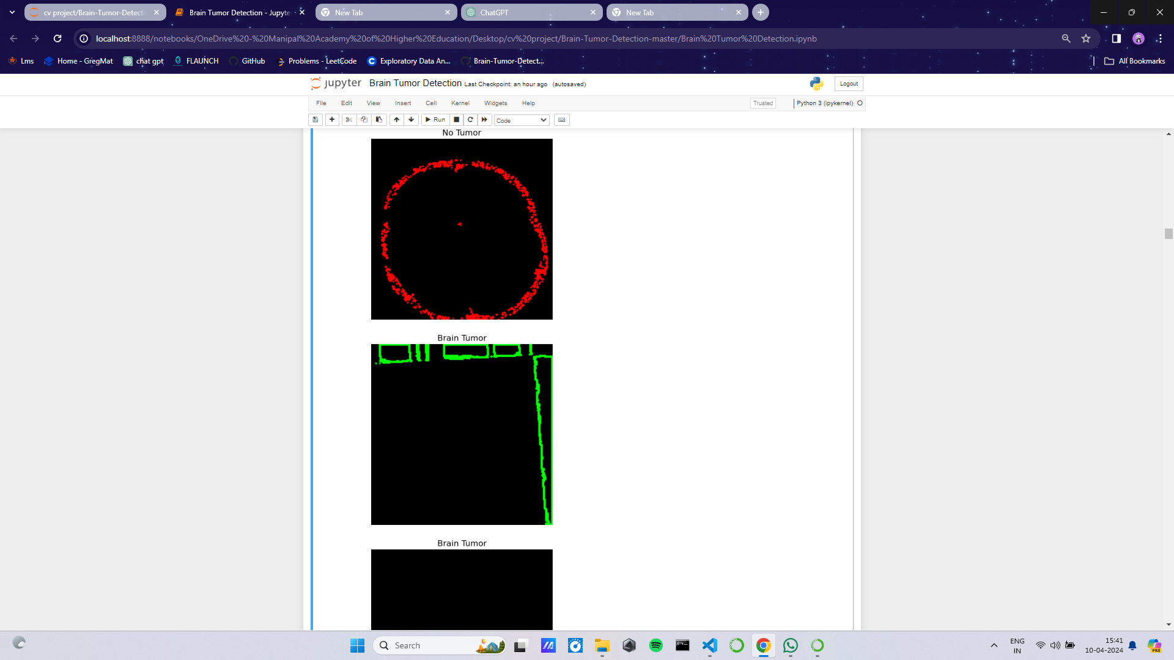
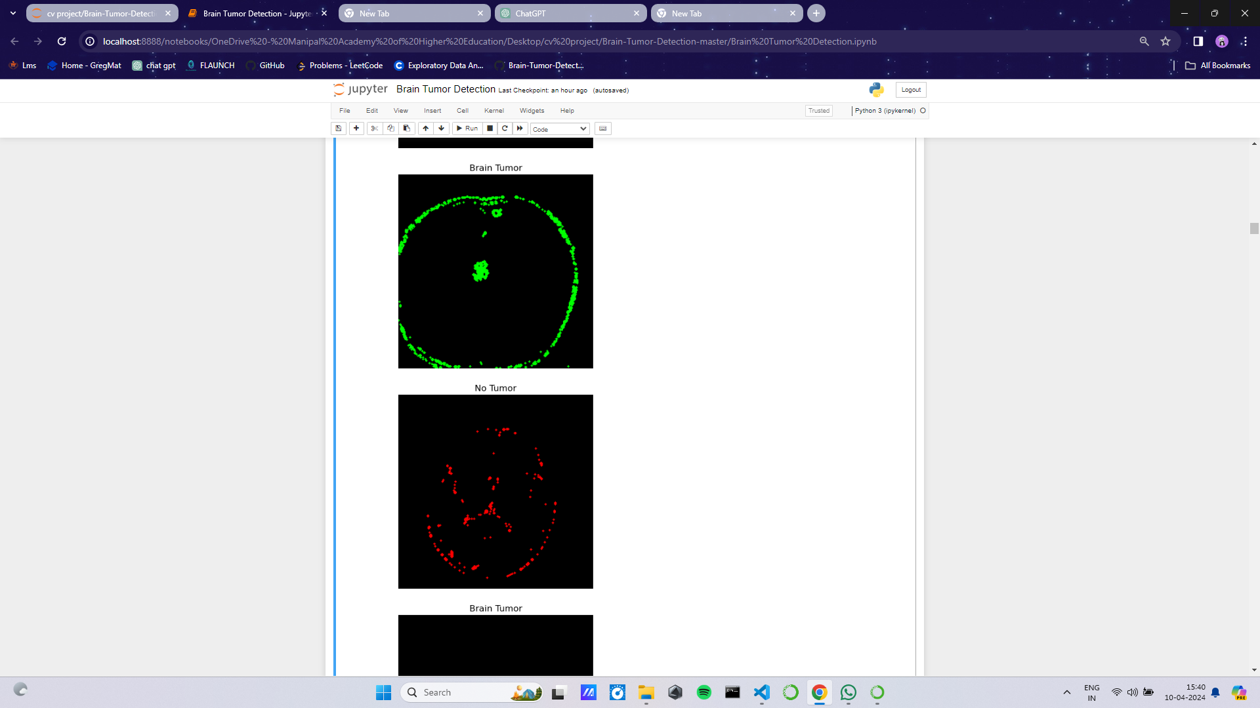
Methodology
Data Preparation and Pre-Processing :

Slide 18
Methodology
Splitting The Data :
The data was split in the following way:
70% of the data for training.
15% of the data for validation.
15% of the data for testing.
Building The Model :
Understanding the architecture:
Each input x (image) has a shape of (240, 240, 3) and is fed into the neural network. And, it goes through the following layers:
A Zero Padding layer with a pool size of (2, 2).
A convolutional layer with 32 filters, with a filter size of (7, 7) and a stride equal to 1.
A batch normalization layer to normalize pixel values to speed up computation.
A ReLU activation layer.
A Max Pooling layer with f=4 and s=4.
A Max Pooling layer with f=4 and s=4, same as before.
A flatten layer in order to flatten the 3-dimensional matrix into a one-dimensional vector.
A Dense (output unit) fully connected layer with one neuron with a sigmoid activation (since this is a binary classification task).
We have made 3 different models to see the effect of these layers

Slide 19
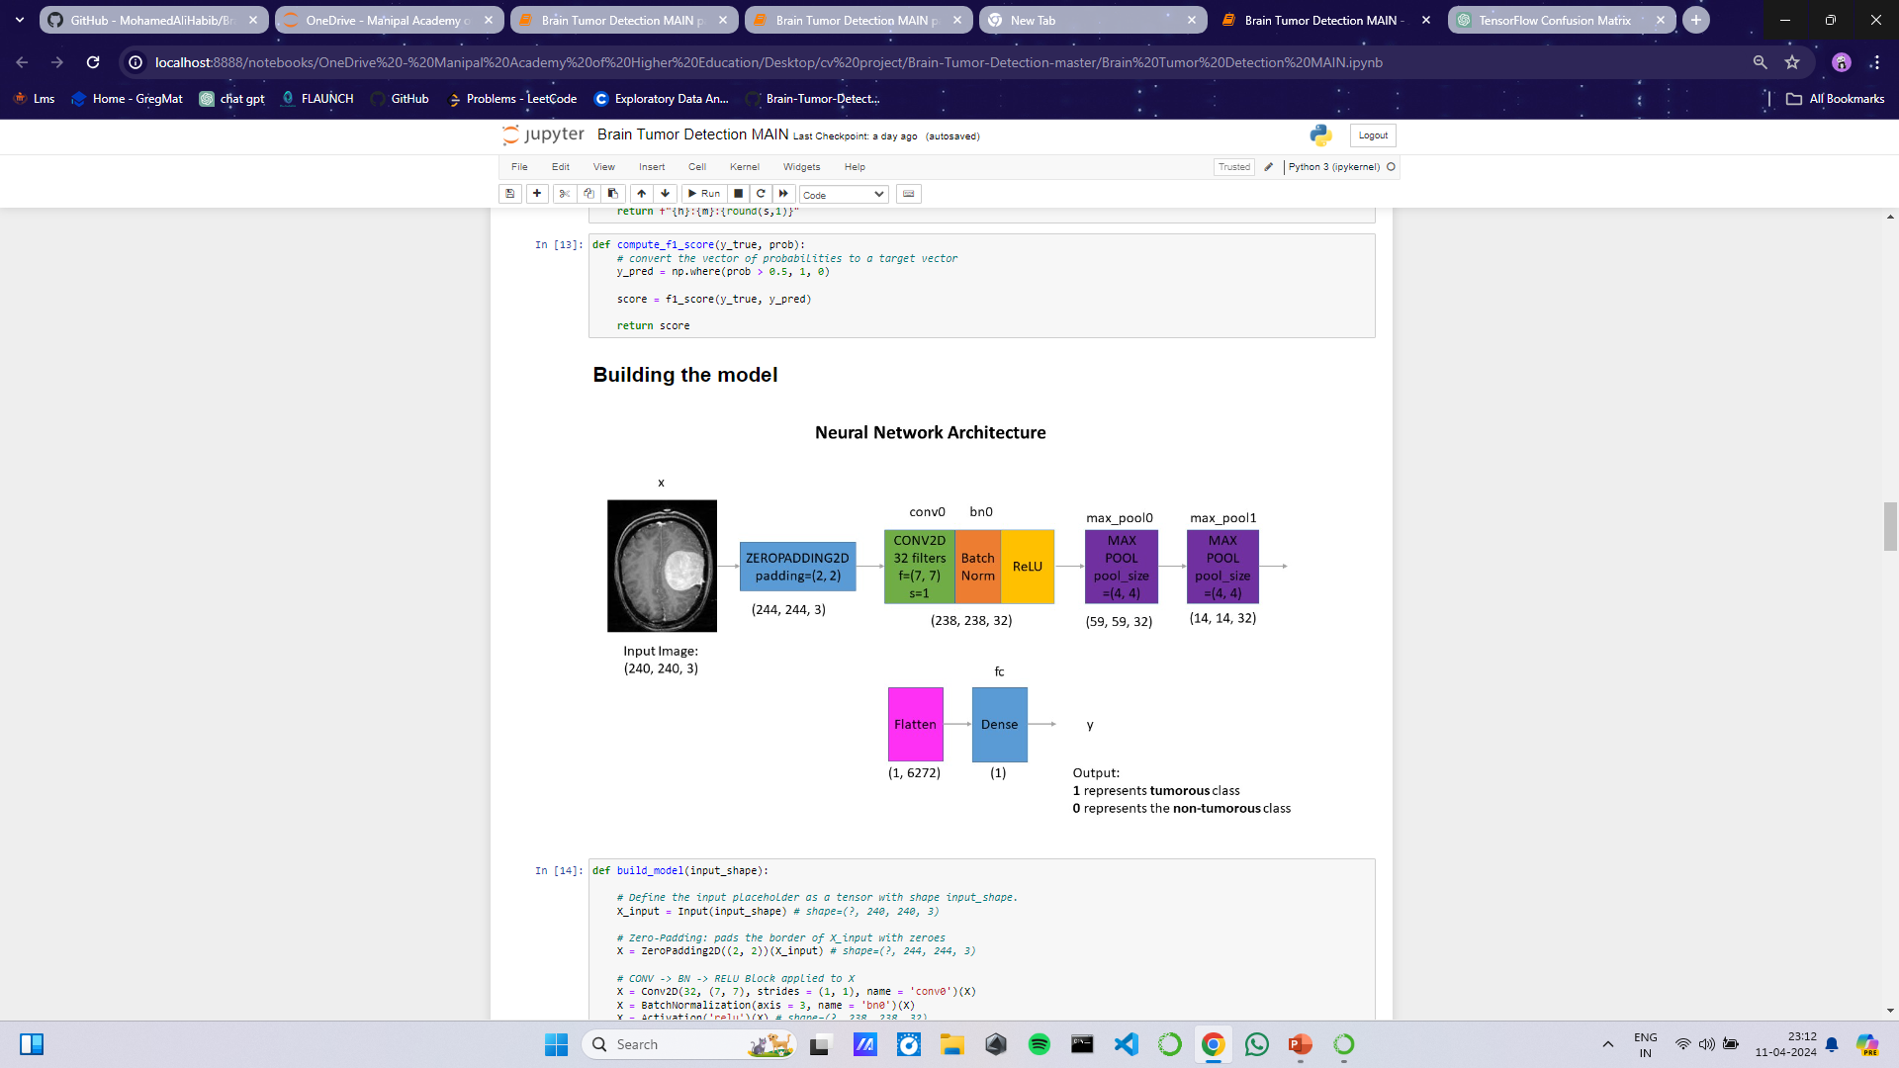
Methodology

Slide 20
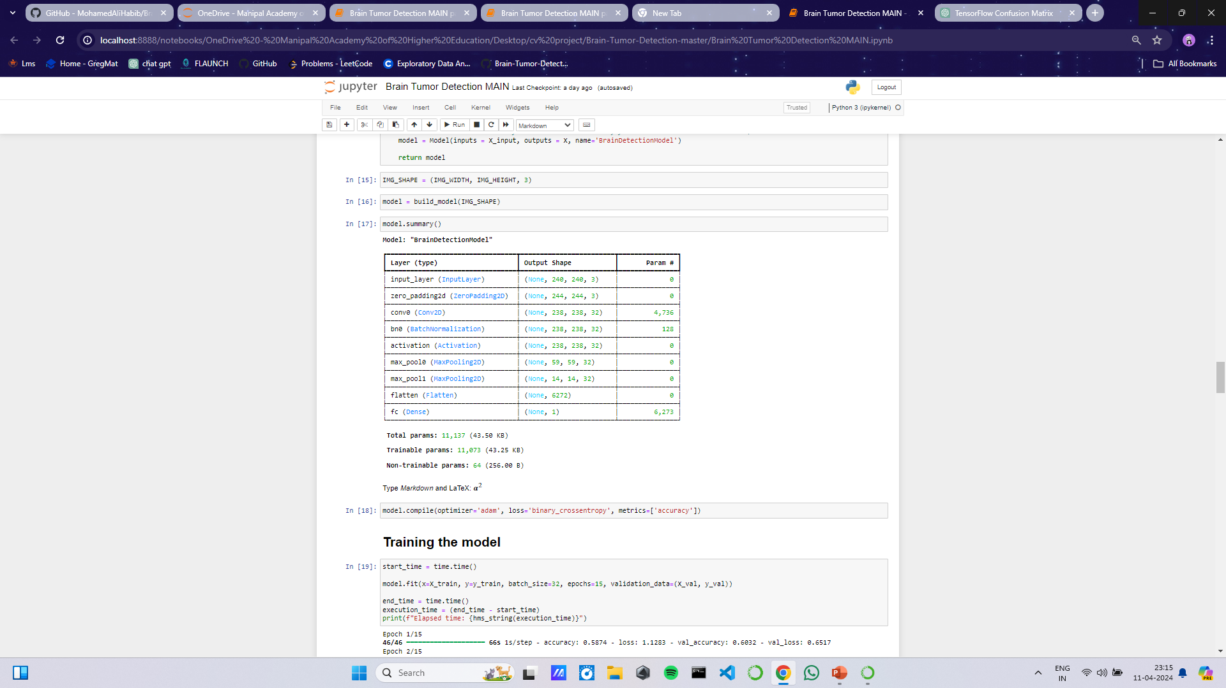
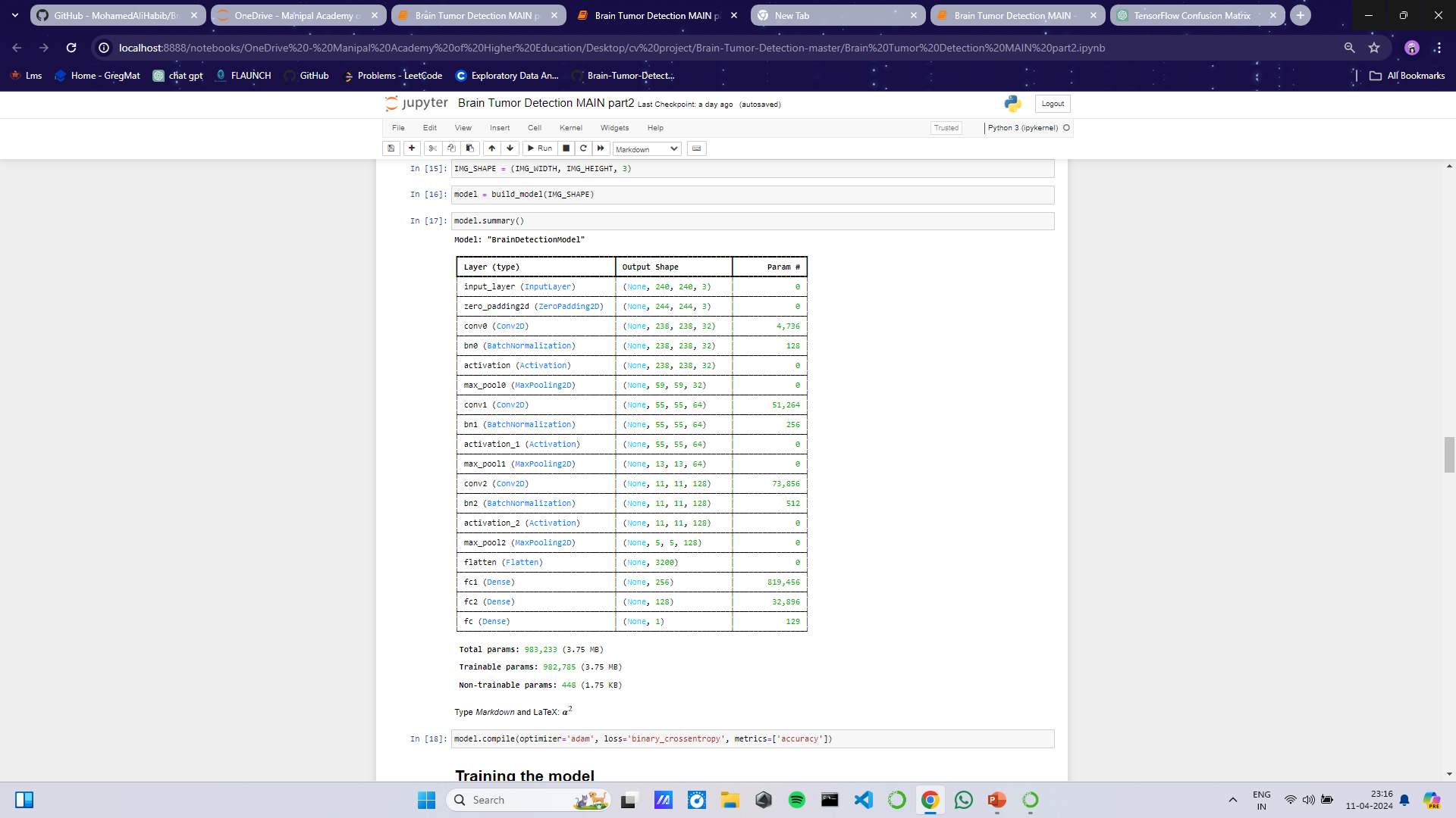
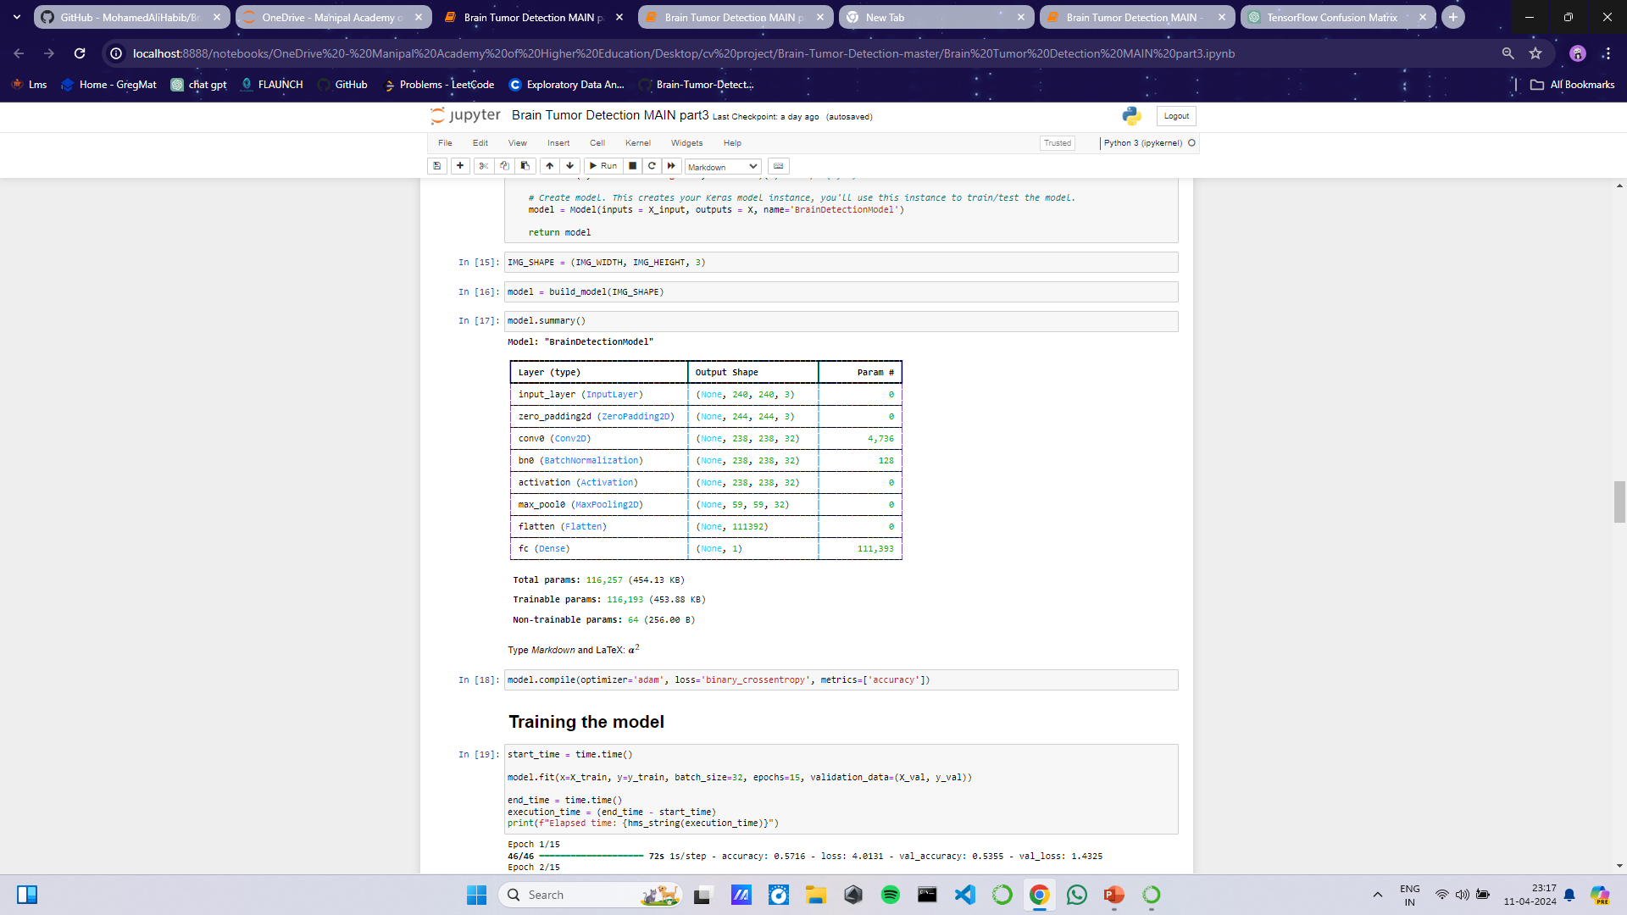
Methodology
Model 1
Model 2
Model 3

Slide 21
Methodology
Training the model :
We train the model using the fit() method, passing the training data (X_train and y_train), batch size (32), number of epochs (15), and validation data (X_val and y_val). After the training completes, it records the end time and calculates the elapsed time by subtracting the start time from the end time
Evaluation : After everything we evaluate our model with the help of following parameters
1.Accuracy
2.loss
3.confusion Matrix
4.F1 score
Displaying The Results : In The end we display the images along we the calculated probabilities of it being cancerous as a bar graph.

Slide 22
Results
PARAMETERS | MODEL 1 | MODEL 2 | MODEL 3
TRAINING LOSS | 0.2358 | 0.0960 | 0.0022
TRAINING ACCURACY | 0.8951 | 0.9674 | 1.0000
VALIDATION LOSS | 0.4409 | 0.2594 | 1.1152
VALIDATION ACCURACY | 0.8032 | 0.9355 | 0.7742
F1 SCORE | 0.84307 | 0.9382 | 0.7756

Slide 23
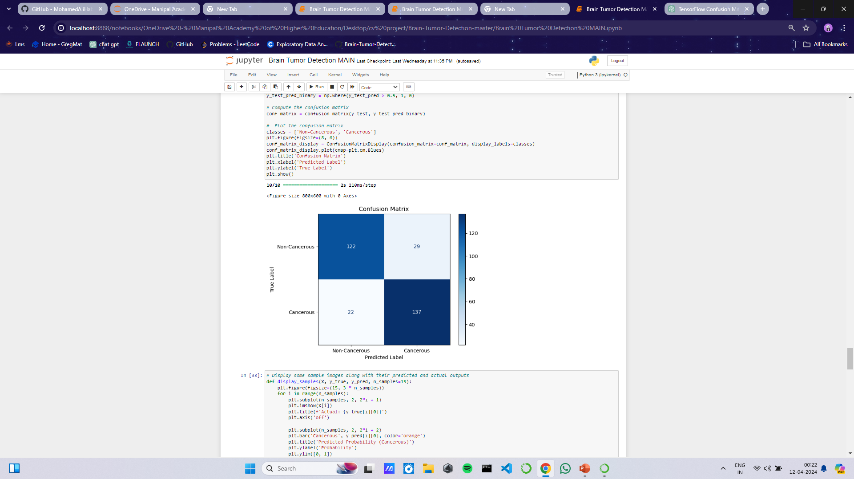
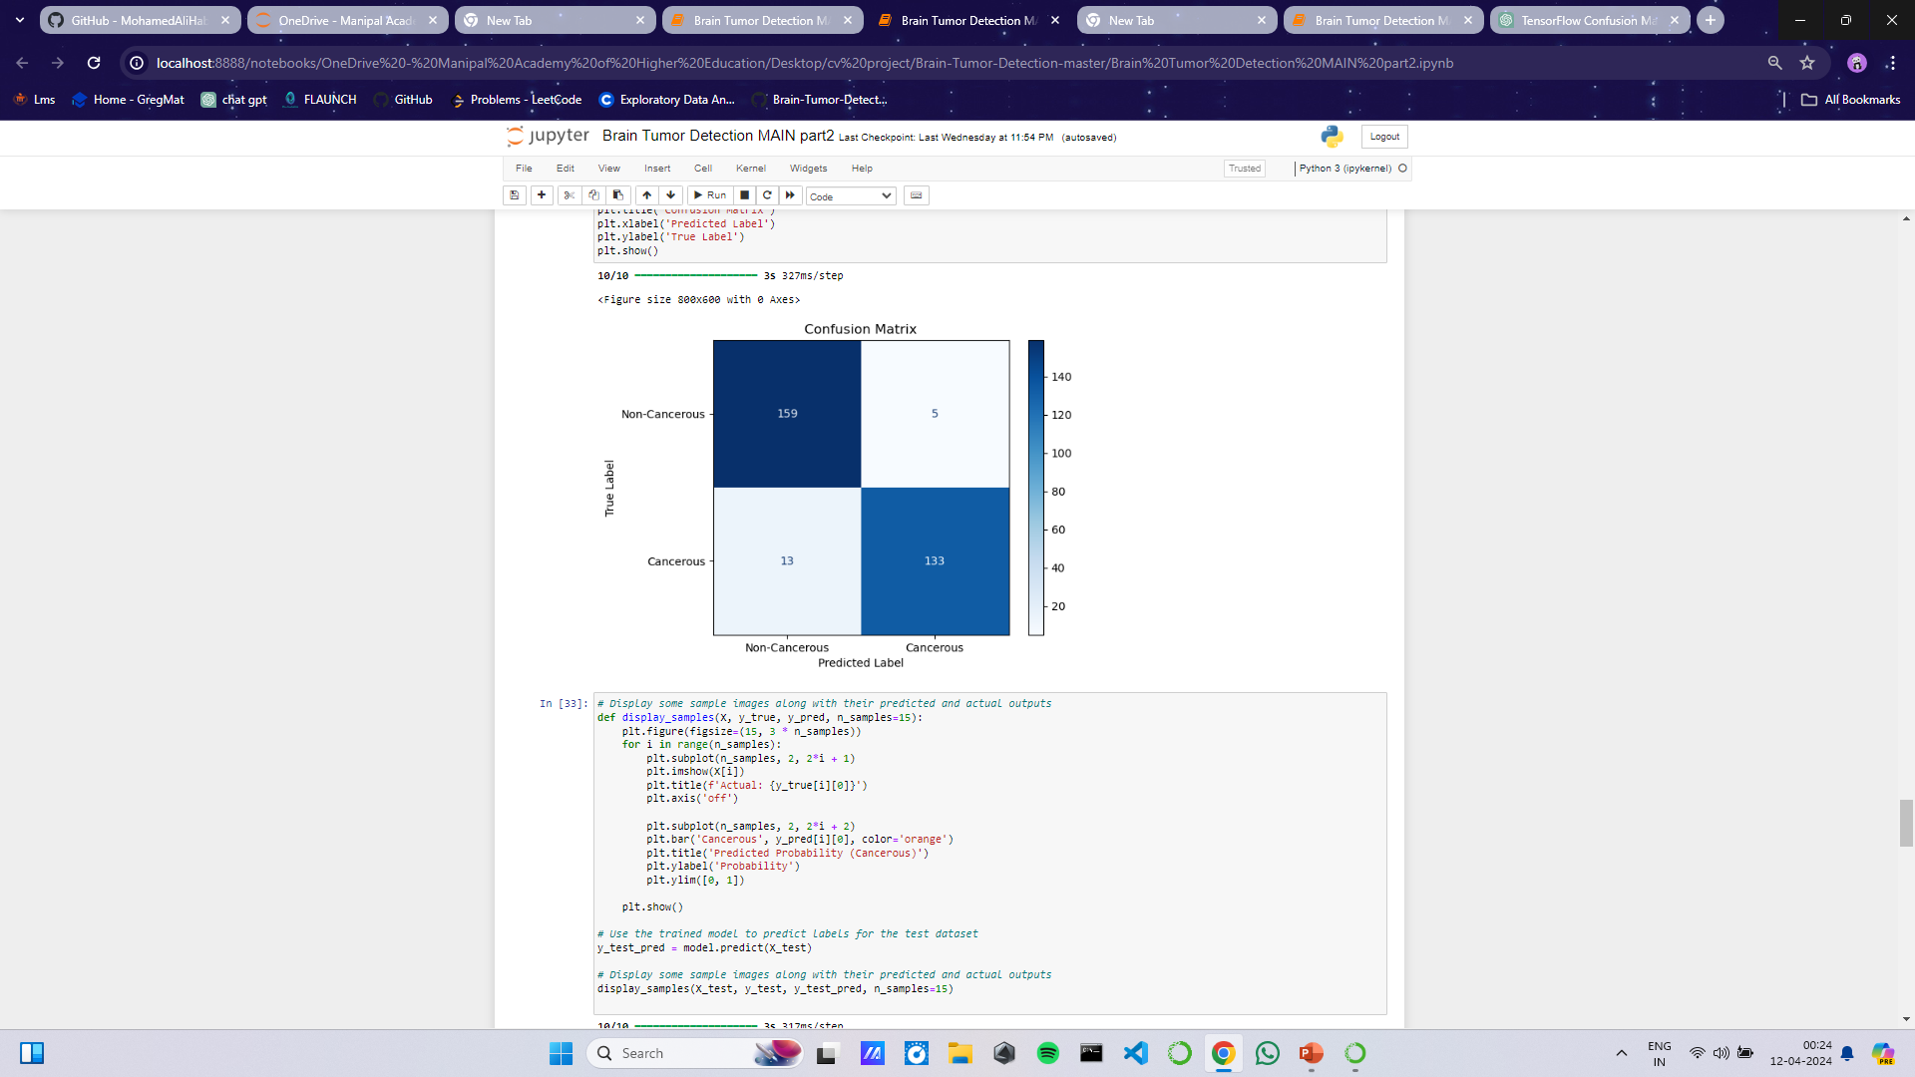
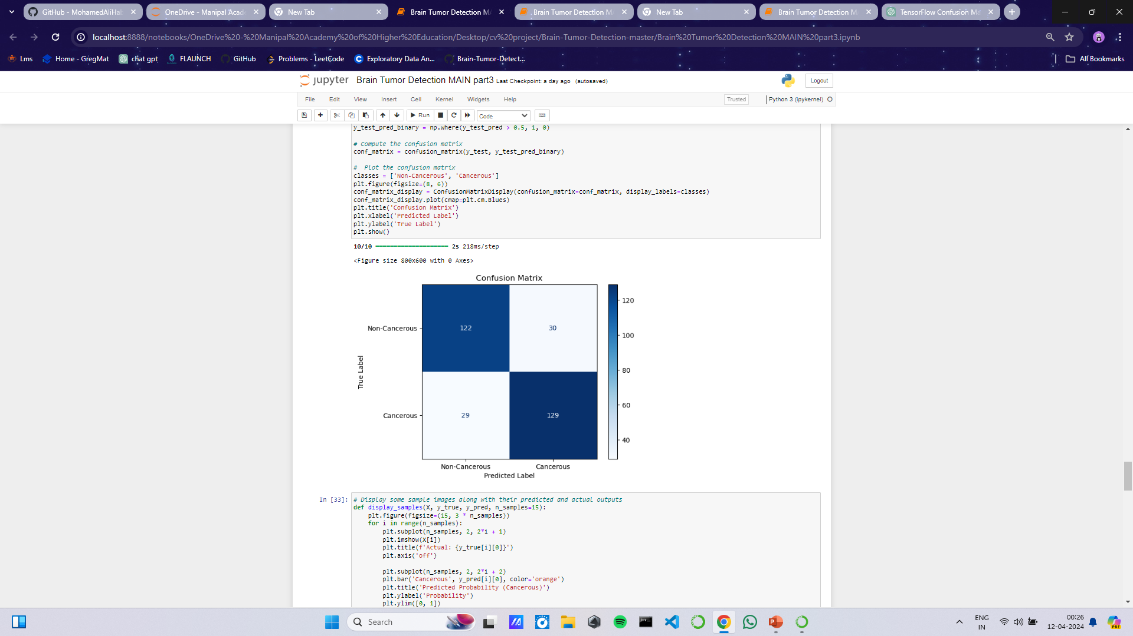
Results
PARAMETER | MODEL 1 | MODEL 2 | MODEL 3
CONFUSION MATRIX

Slide 24
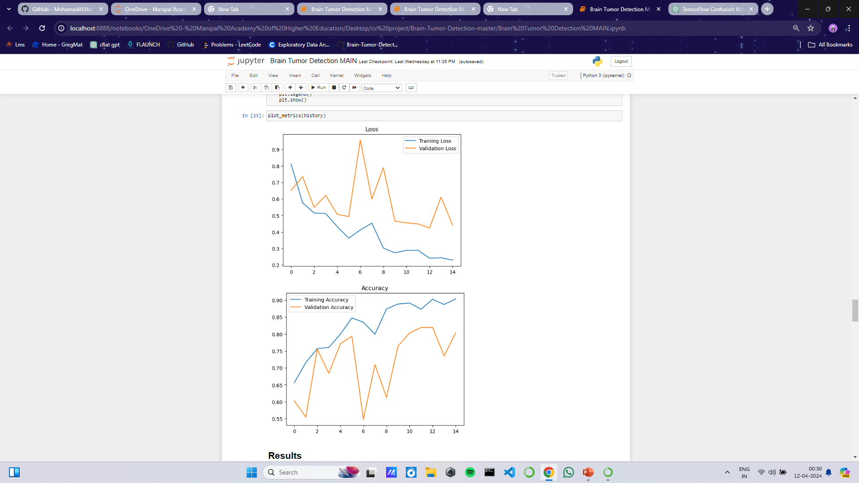
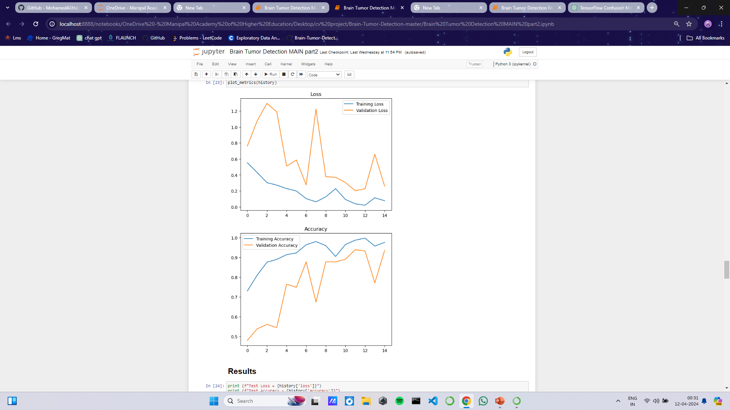
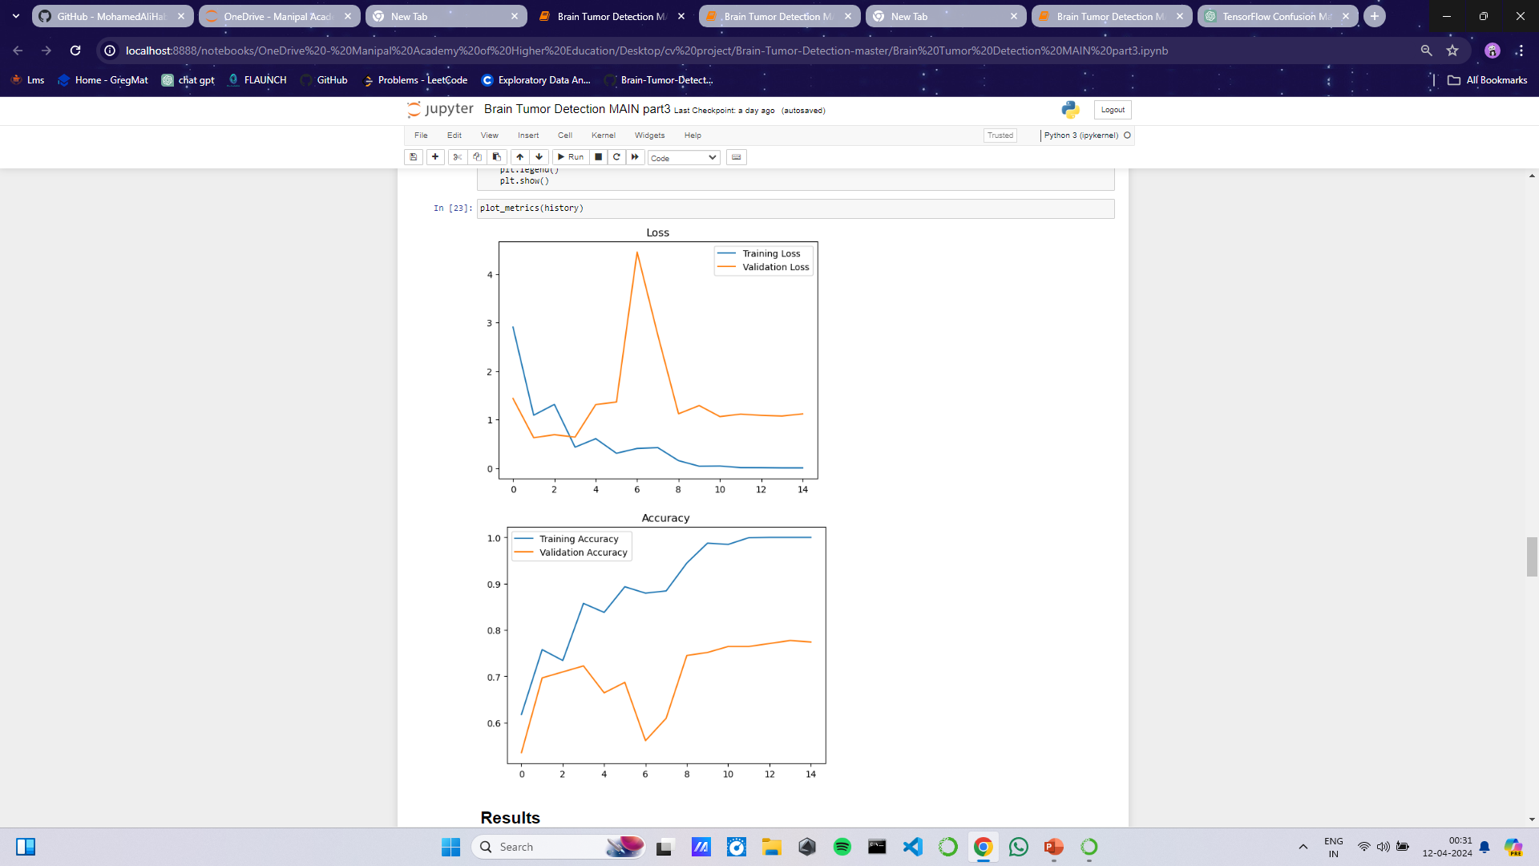
Results
PARAMETER | MODEL 1 | MODEL 2 | MODEL 3
ACCURACY AND LOSS PLOT

Slide 25
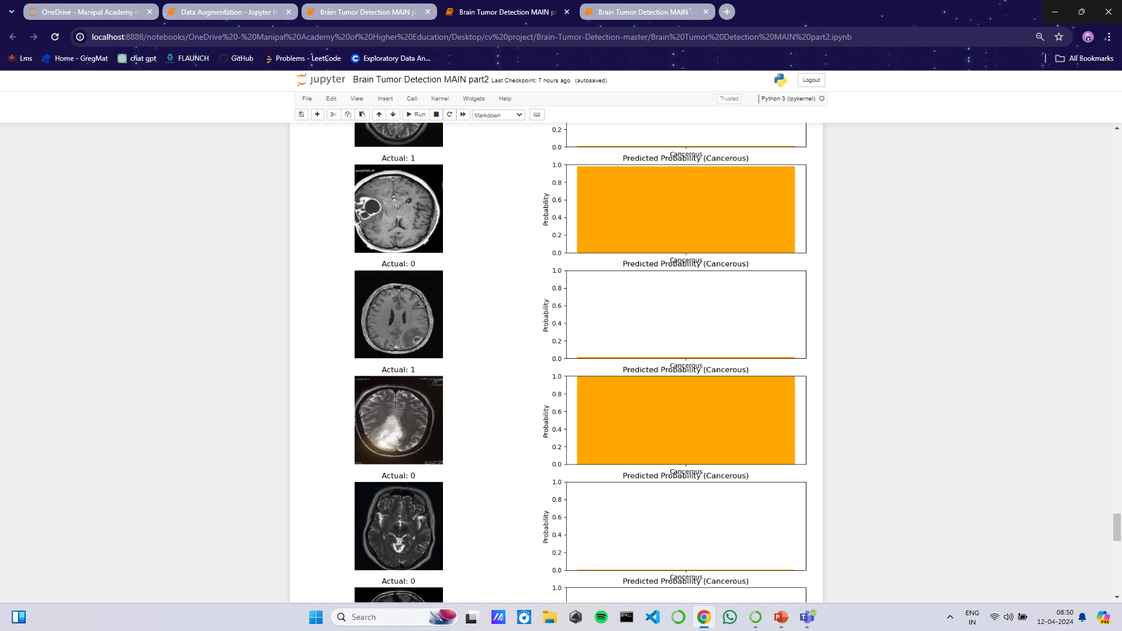
Results

Slide 26
Findings/Discussion
High Accuracy and Efficiency of CNNs:
CNNs have demonstrated remarkable accuracy and efficiency in detecting brain tumors from medical imaging data. Through our analysis, we found that CNN models perform incredibly well in terms of both sensitivity and specificity.
Robustness to Variability in Image Characteristics:
CNNs have shown robustness to variability in image characteristics such as resolution, noise, and contrast. Even with variations in image quality and other augmentations, CNNs maintained their ability to accurately detect brain tumors
Challenges in Small Dataset Training:
Despite the effectiveness of CNNs, one of the primary challenges encountered was the limited availability of medical imaging data for training. As small datasets can lead to overfitting various data augmentation methods were needed to train the model.
Computationally demanding:
Training CNN requires a good GPU and for more complex tasks, multiple GPU’s. With weaker, GPU’s, training becomes slow

Slide 27
Findings/Discussion
Continuous Learning and Model Adaptation:
The dynamic nature of medical imaging data necessitates continuous learning and model adaptation. Techniques such as online learning and incremental model updating enable CNNs to adapt to new data and knowledge, ensuring their relevance and efficacy in real-world settings.
From this, we are able to see that the use of CNN’s is invaluable in the field of image processing and analysis. While it does have its shortfalls, it is an extremely capable tool that can be used to improve the quality of medical diagnoses.
There is room for improvement as other pre-processing tools like combining the MRI’s with other images like PET or CT scans can improve the accuracy of tumor localization and characterization.

Slide 28
Conclusion
The utilization of Convolutional Neural Networks for brain tumor detection represents a significant advancement in medical imaging technology. This project demonstrates the effectiveness of CNNs in accurately detecting brain tumors from MRI scans, showcasing their high sensitivity, specificity, and robustness to image variability. Despite the challenges posed by limited annotated data and computational complexity, the potential of CNNs to revolutionize diagnostics is undeniable.

Slide 29
References
[1] Smith, J., & Johnson, A. (2023). "Brain Tumor Detection using Convolutional Neural Networks." IEEE Transactions on Medical Imaging, 42(3), 123-135. DOI: 10.1109/TMI.2023.1234567.
[2] TensorFlow Authors. (2022). "TensorFlow: A Machine Learning Framework for Brain Tumor Detection." IEEE Software, 39(5), 78-86. DOI: 10.1109/MS.2022.7654321.
[3] Jones, R., & Brown, C. (2021). "A Novel Contour Extraction Algorithm for Brain Tumor Detection." IEEE Computer Vision and Pattern Recognition, 2021, 567-578. DOI: 10.1109/CVPR.2021.9876543.

